Slide 1

Big Data Analytics Strategy and Roadmap
Srinath Perera
Director, Research, WSO2
(srinath@wso2.com,
@srinath_perera)

Slide 2

Once Upon a time, there lived a wise Boy
The king being unhappy with the Boy, asked him a “Big Data question”
We had Big data problems though time, although could not solve them
Early examples
Census at Egypt (3000 BC)
Census at Egypt (AD 144) that counted 49.73 million

Slide 3

A day in your life
Think about a day in your life?
What is the best road to take?
Would there be any bad weather?
How to invest my money?
How is my health?
There are many decisions that you can do better if only you can access the data and process them.
http://www.flickr.com/photos/kcolwell/5512461652/ CC licence

Slide 4
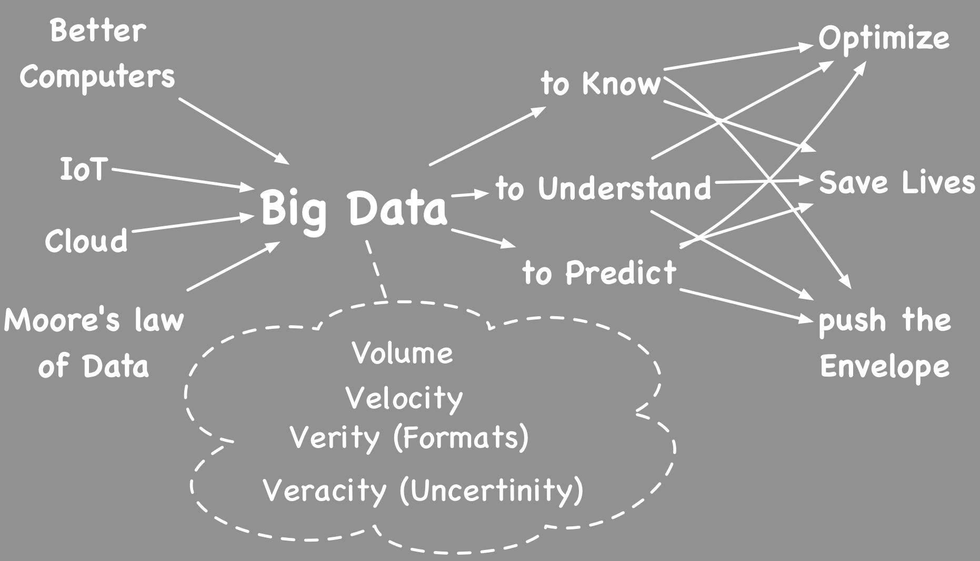

Slide 5
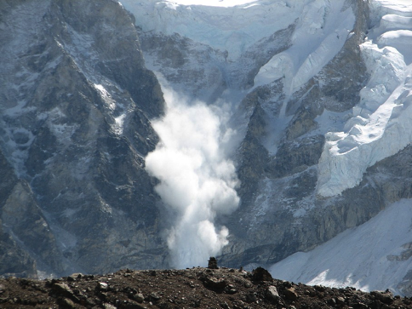
Data Avalanche (Moore’s law of data)
We are now collecting and converting large amount of data to digital forms
90% of the data in the world today was created within the past two years.
Amount of data we have doubles very fast

Slide 6
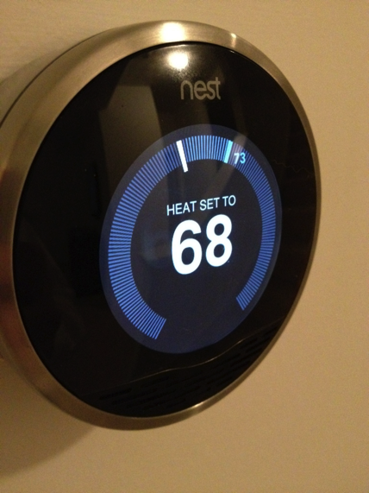
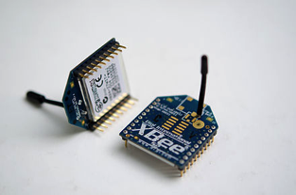


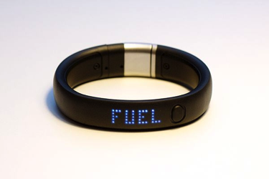
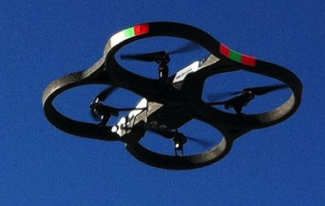
Internet of Things
Currently physical world and software worlds are detached
Internet of things promises to bridge this
It is about sensors and actuators everywhere
In your fridge, in your blanket, in your chair, in your carpet.. Yes even in your socks
Google IO pressure mats

Slide 7
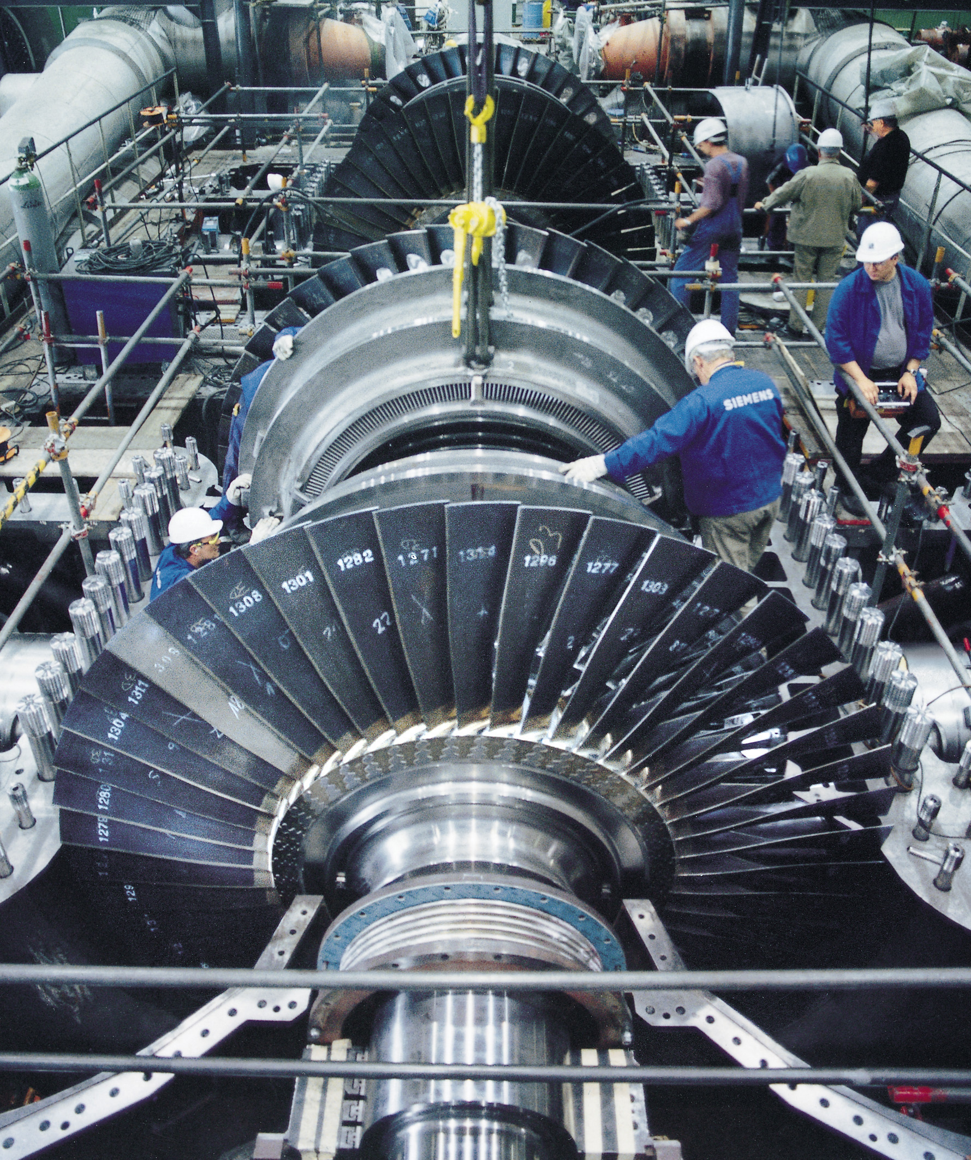

What can we do with Big Data?
Optimize
1% saving in Airplanes and turbines can save more than 1B$ each year (GE talk, Strata 2014). Sri Lanka’s total export 9B year
Save lives
Weather, Disease identification, Personalized treatment
Technology advancement
Most high tech work are done via simulations

Slide 8
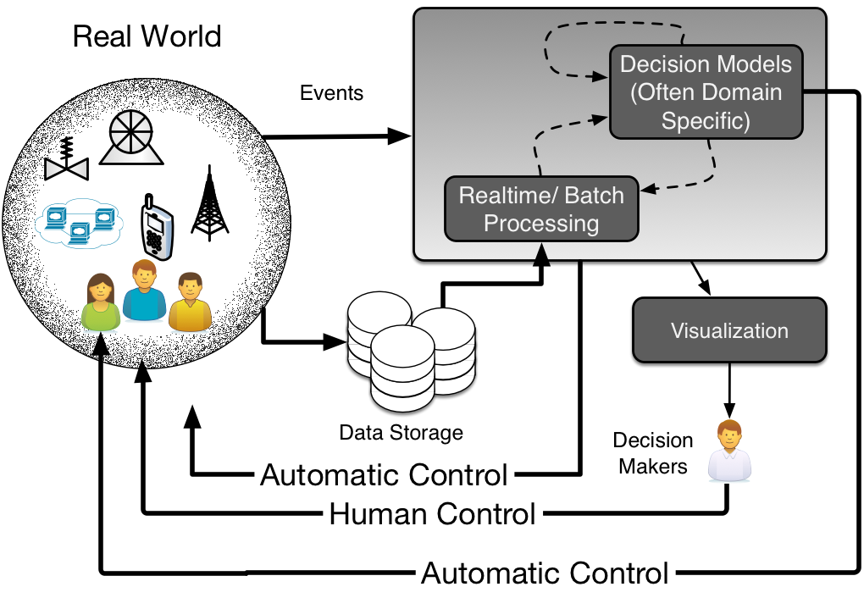
Big Data Reference Architecture

Slide 9

Why Big Data is hard?
How to store? Assuming 1TB bytes it takes 1000 computers to store a 1PB
How to move? Assuming 10Gb network, it takes 2 hours to copy 1TB, or 83 days to copy a 1PB
How to search? Assuming each record is 1KB and one machine can process 1000 records per sec, it needs 277CPU days to process a 1TB and 785 CPU years to process a 1 PB
How to process?
Convert algorithms to work in large size
Create new algorithms
http://www.susanica.com/photo/9

Slide 10
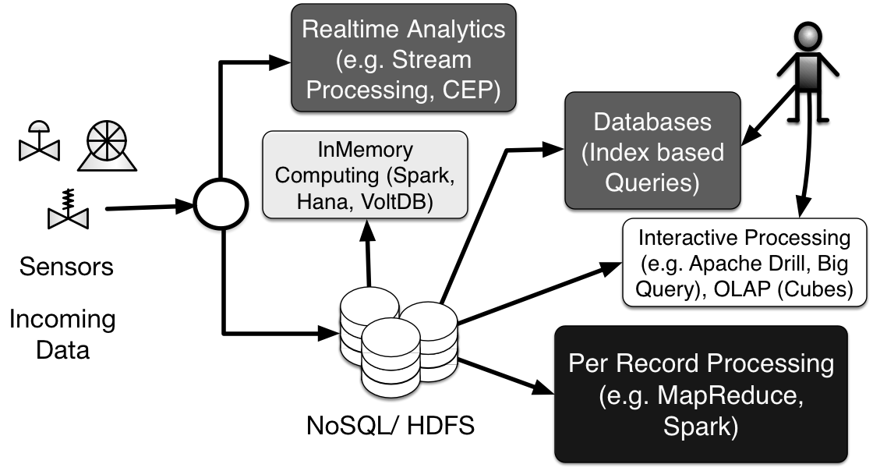
Big data Processing Technologies

Slide 11
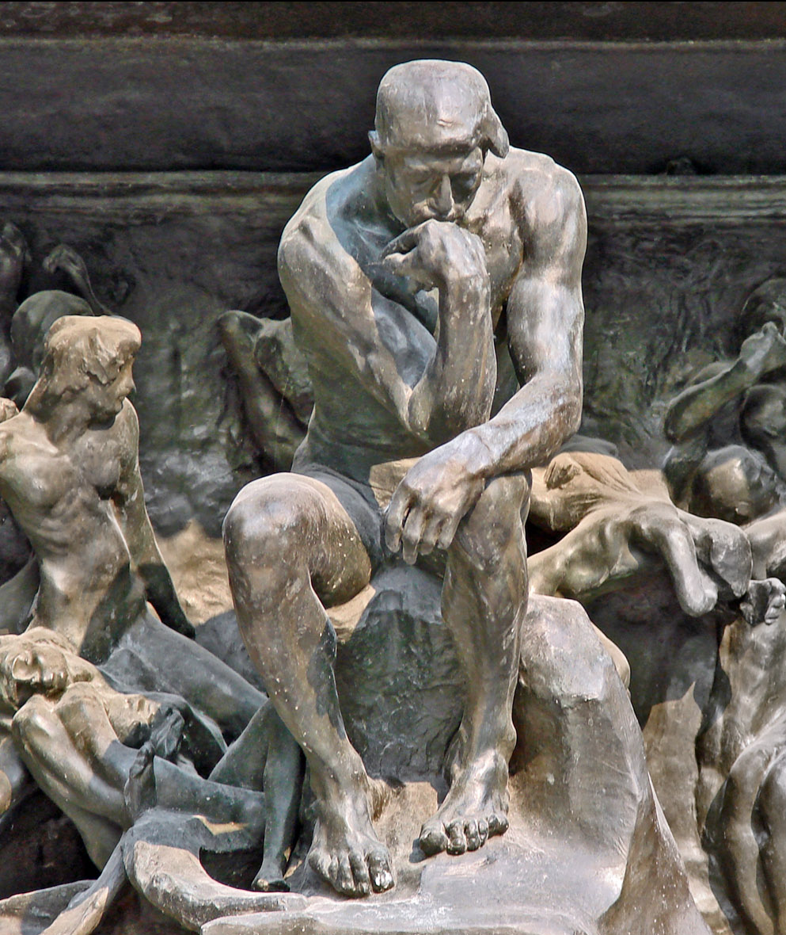
Making Sense of Data
To know what happened? (hindsight + oversight)
Basic analytics + visualizations (min, max, average, histogram, distribution)
Interactive drill down
To explain why?(Insight)
Data mining, classifications, building models, clustering
To forecast (Foresight)
Neural networks, decision models

Slide 12
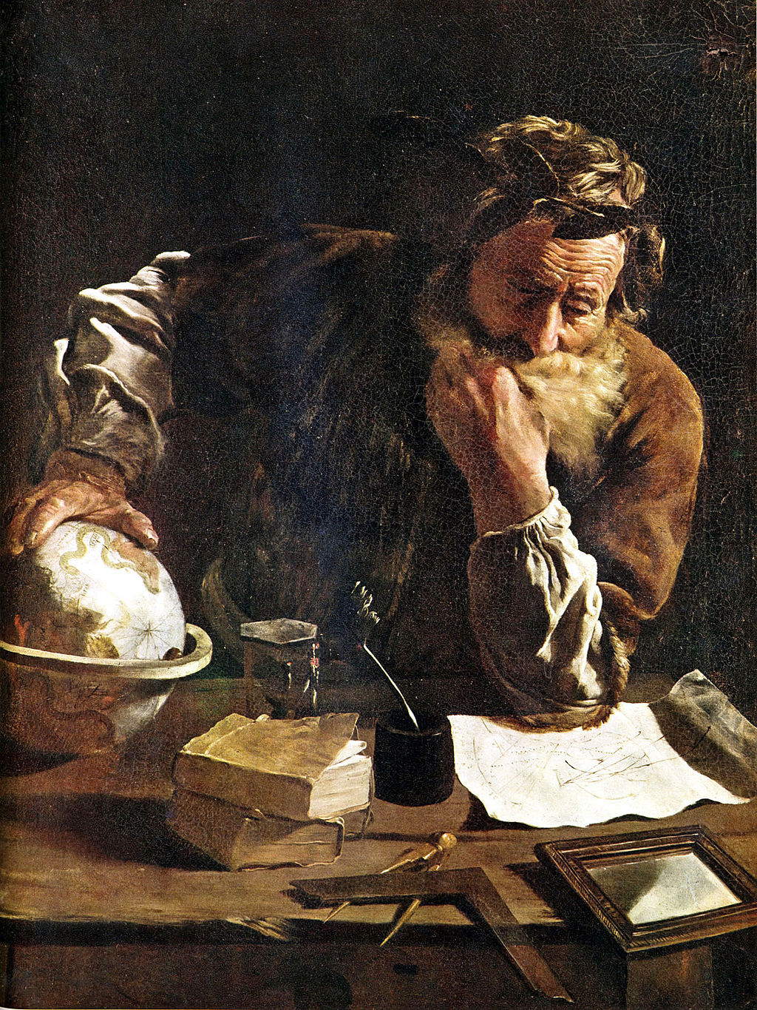
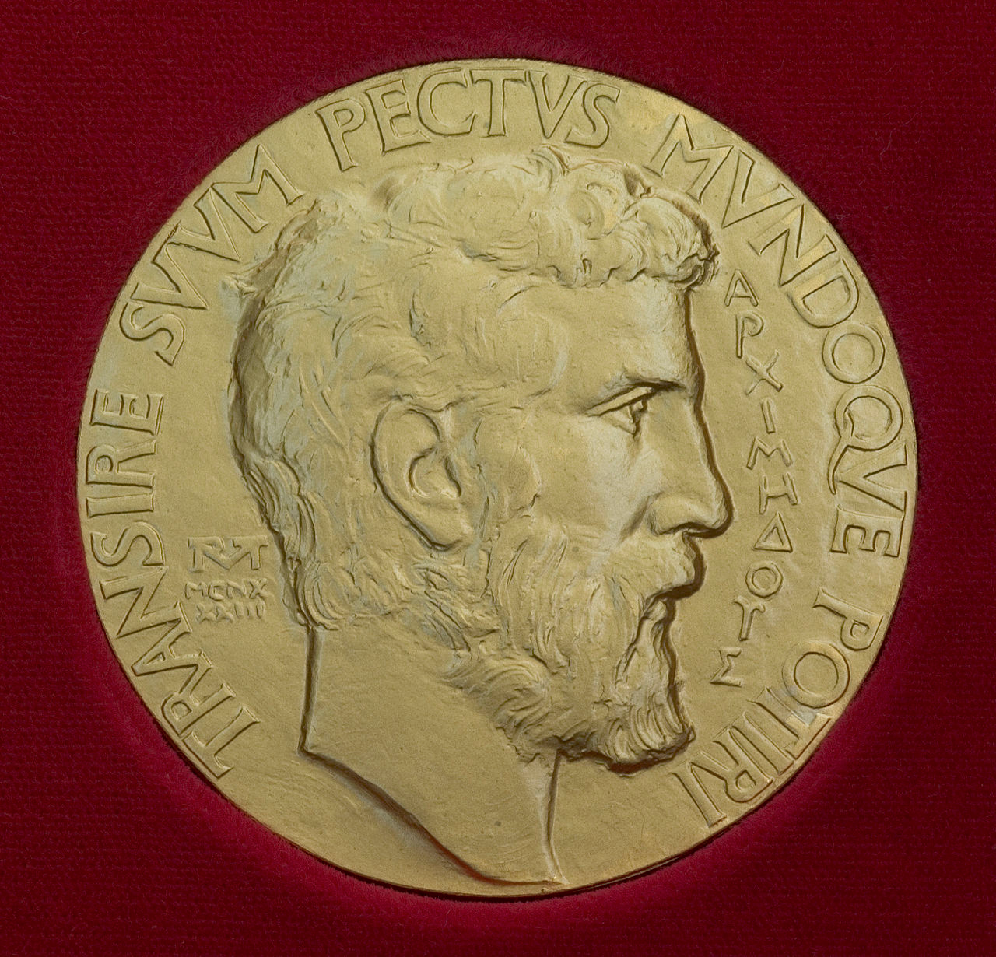
New Developments
Internet of things (IoT)
Building a bridge between software and real world.
Lambda Architecture
Merging realtime and batch processing in a same model
Machine Learning
Next Generation decisions (e.g. Deep Learning)

Slide 13
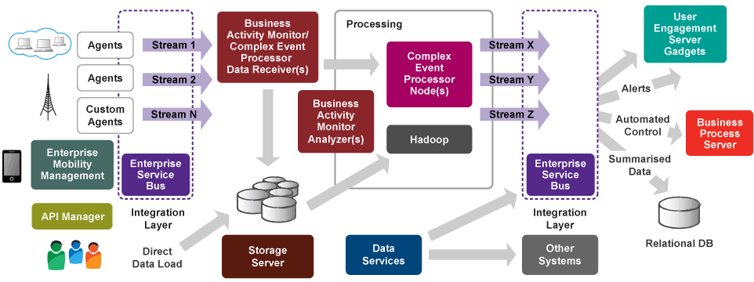
WSO2 Big Data Platform

Slide 14
Data Collection
Agent agent = new Agent(agentConfiguration);
publisher = new AsyncDataPublisher(
"tcp://localhost:7612", .. );
StreamDefinition definition =
new StreamDefinition(STREAM_NAME,
VERSION);
definition.addPayloadData("sid", STRING);
...
publisher.addStreamDefinition(definition);
...
Event event = new Event();
event.setPayloadData(eventData);
publisher.publish(STREAM_NAME, VERSION, event);
Can receive events via SOAP, HTTP, JMS, ..
WSO2 Events is highly optimized version (400K events TPS)
Default Agents and you can write custom agents.

Slide 15
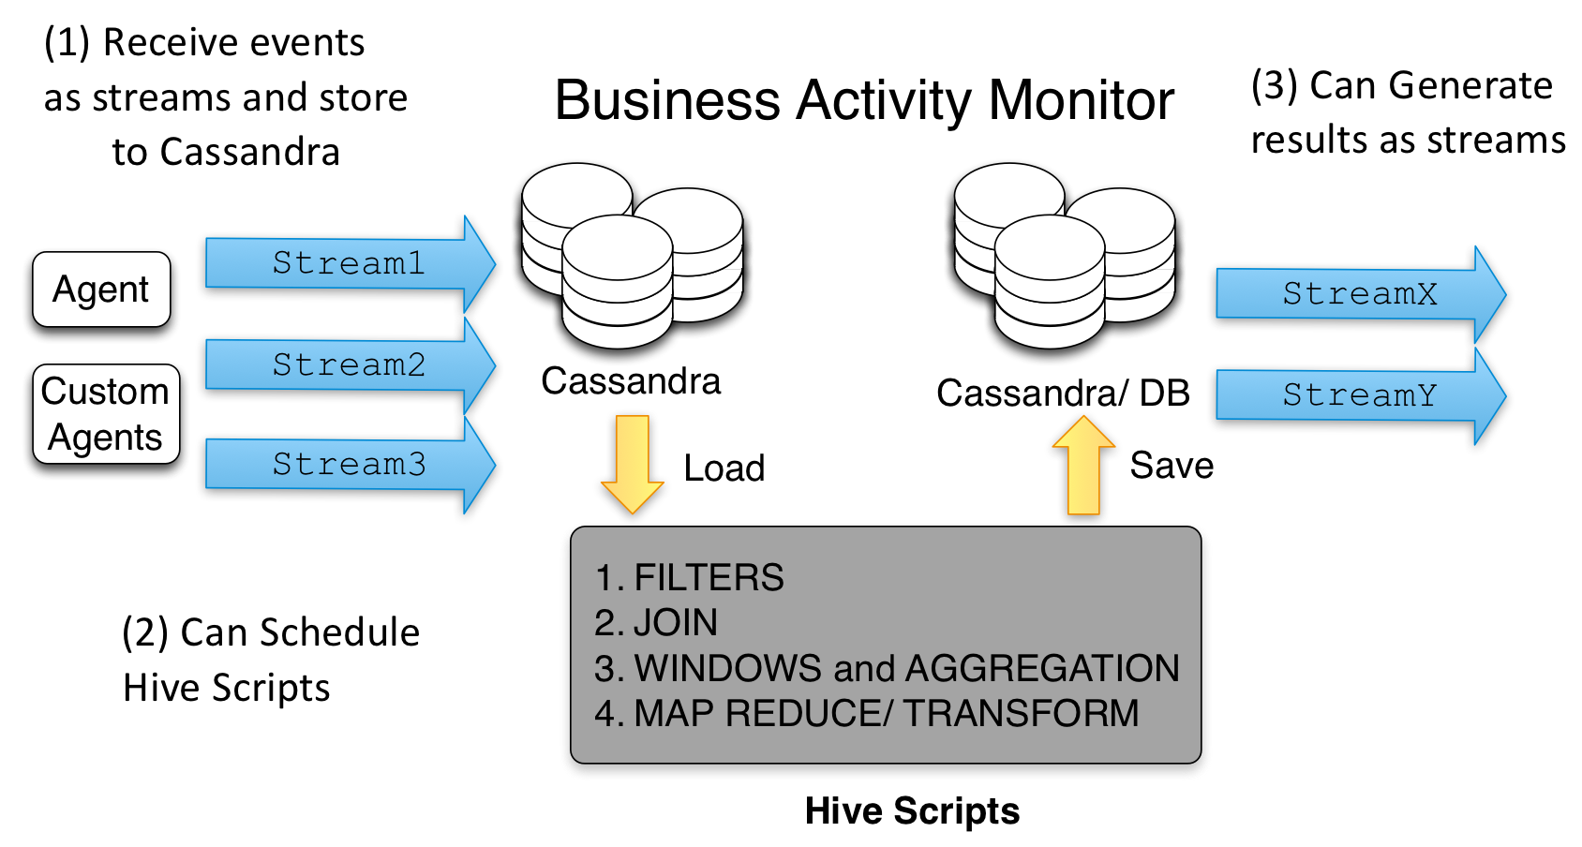
Business Activity Monitor

Slide 16
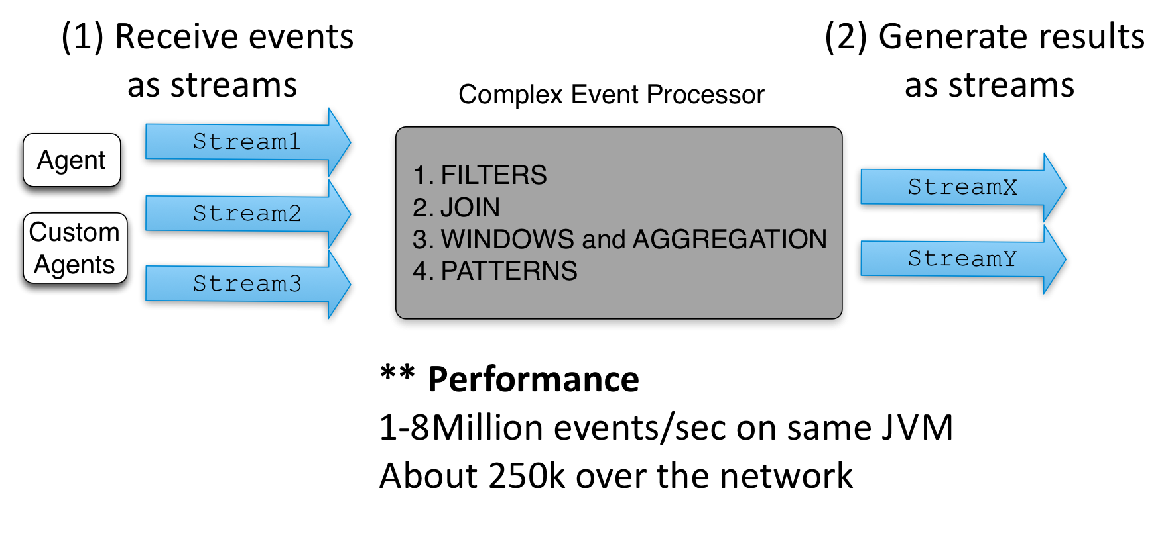
Complex Event Processor

Slide 17
What is new?

Slide 18
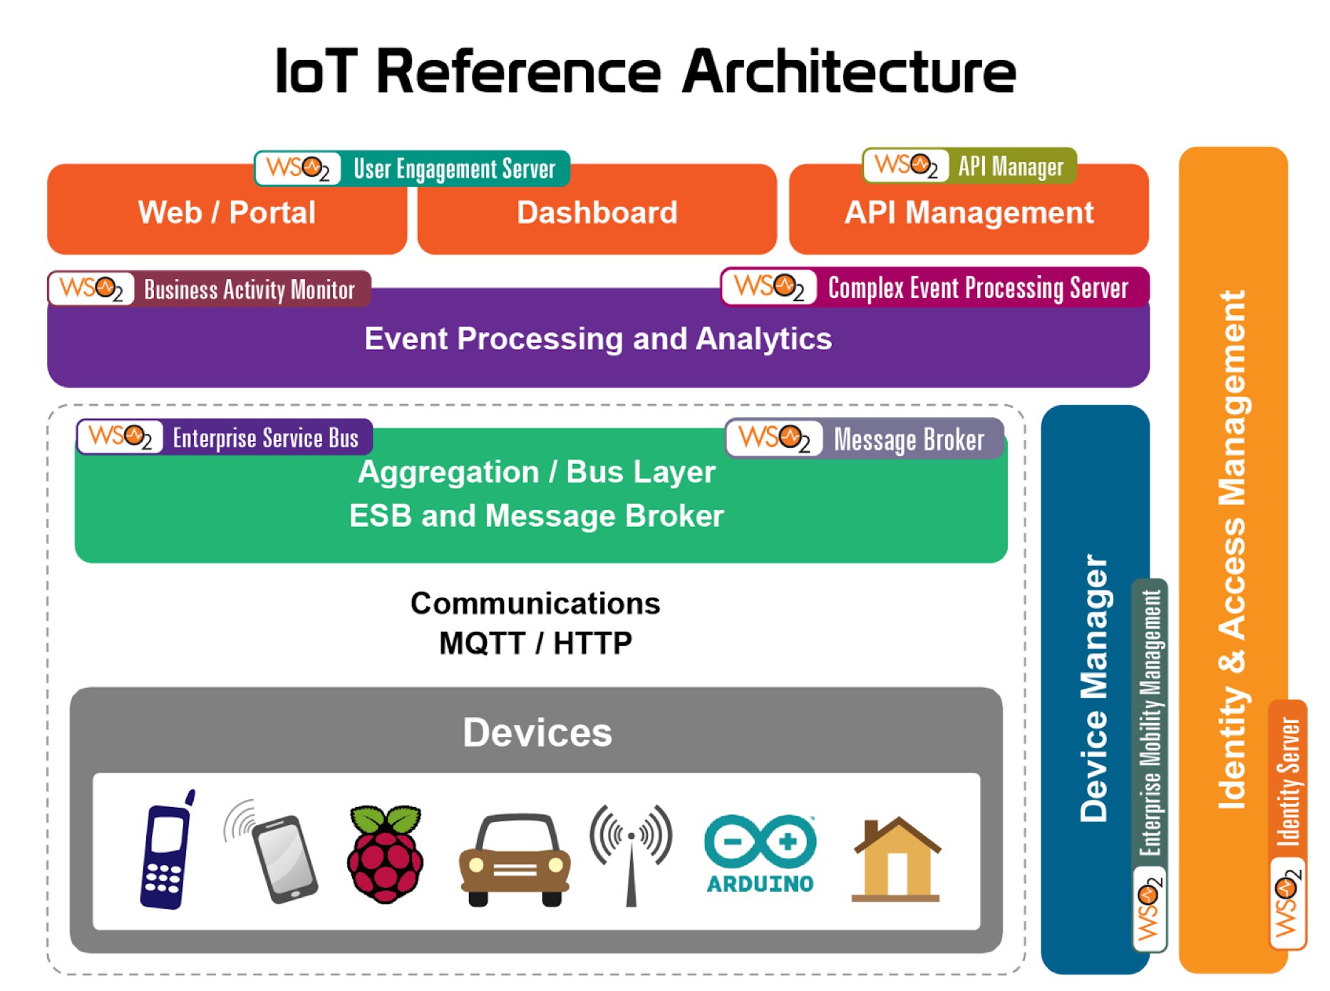

Slide 19
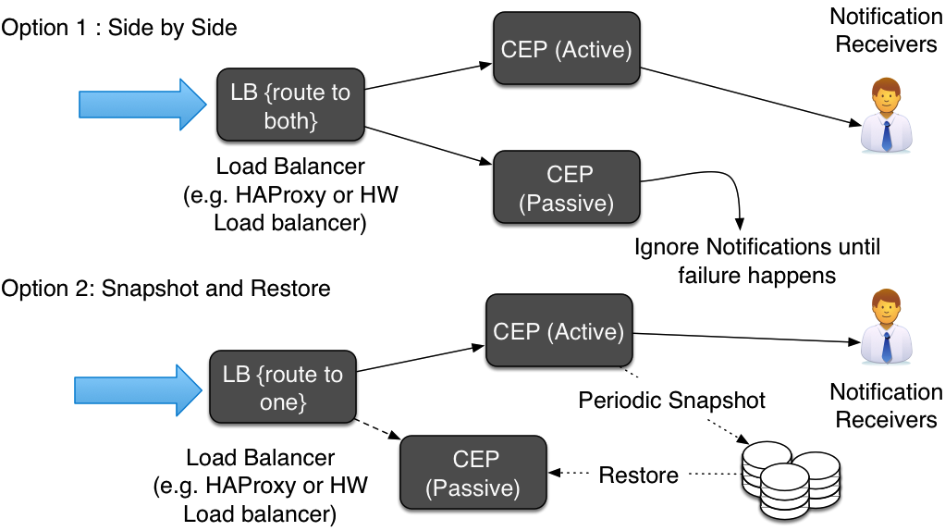
CEP High Availability

Slide 20
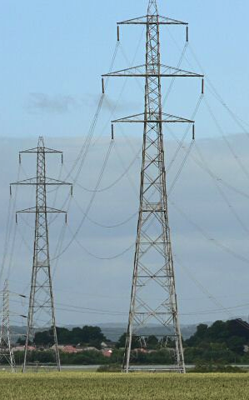
ACM DEBS Grand Challenge 2014
DEBS (Distributed Event Based Systems) is a premier academic conference, which post yearly event processing challenge
Smart Home electricity data: 2000 sensors, 40 houses, 4 Billion events
WSO2 CEP based solution is one of the four finalists (Others Dresden University of Technology and Fraunhofer Institute (Germany), and Imperial College London)
We posted fastest single node solution measured (400K events/sec) and close to one million distributed throughput.

Slide 21
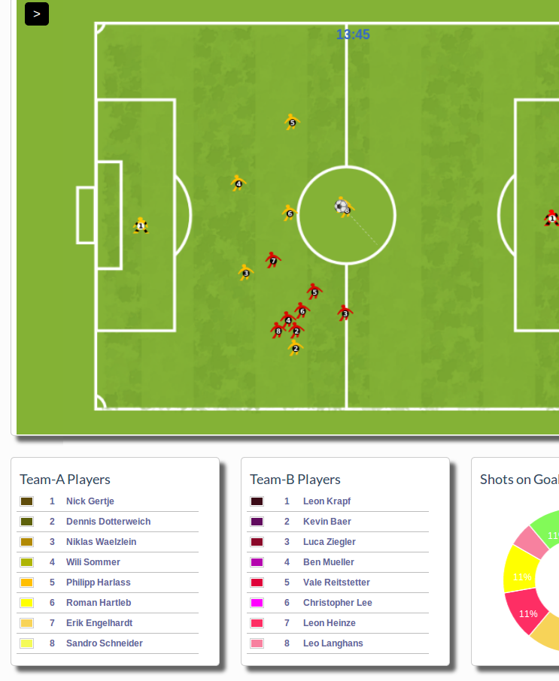
Dashboard Wizard for BAM and CEP
We have been asking you to write bit of code to get visualizations up
But we have now added a wizard, that guide you though the process
Think it as a “New Servlet” menu, you can customize what it is generated.
Already in latest CEP and BAM
Currently only DBs as data sources, and simple graphs, but that will grow!

Slide 22
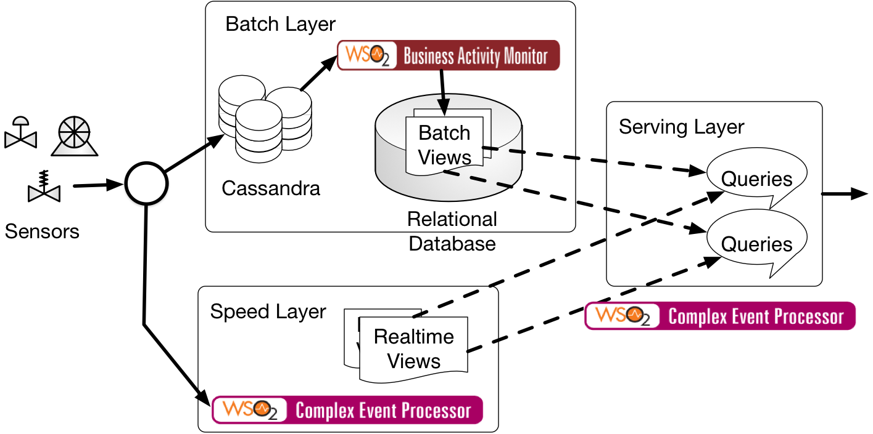
Lambda Architecture with WSO2 Products

Slide 23
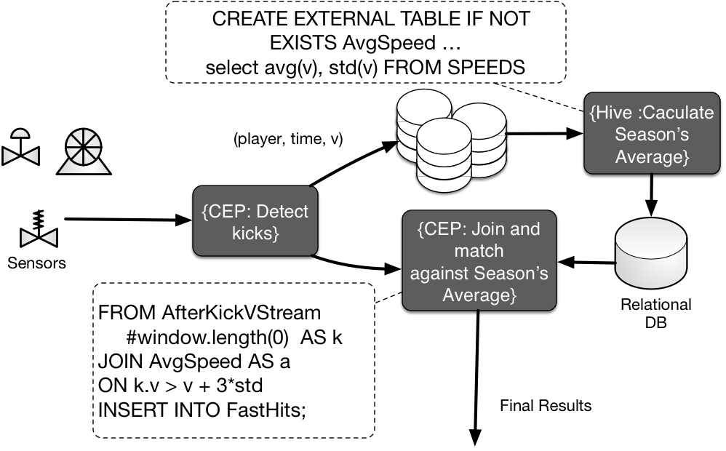

Slide 24
What keeping us busy?

Slide 25
Scaling Complex Event Processing
“CEP vs. Stream Processing” is like Hive vs. Hadoop. Former let users write SQL like queries without implementing things from ground up
However scaling is the main challenge
We have written a Siddhi bolt for Storm. Now you can do distributed processing by connecting Siddhi bolts together!
SiddhiBolt siddhiBolt1 = new SiddhiBolt( .. siddhi queries ..);
SiddhiBolt siddhiBolt2 = new SiddhiBolt( .. siddhi queries .. );
TopologyBuilder builder = new TopologyBuilder();
builder.setSpout("source", new PlayStream(), 1);
builder.setBolt("node1", siddhiBolt1, 1)
.shuffleGrouping("source", "PlayStream1");
..
builder.setBolt("LeafEacho",
new EchoBolt(), 1)
.shuffleGrouping("node1", "LongAdvanceStream");
..
cluster.submitTopology("word-count", conf, builder.createTopology());

Slide 26
CEP Query => Distributed Execution
define partition on Palyer.sid{
from Player#window(30s)select avg(v)as v insert into AvgSpeedByPlayer;
}
from AvgSpeedByPlayer avg(v) insert into AvgSpeed;
Extend Siddhi language to include parallel constructs partitions, pipelines, distributed operators
Compile queries to a Storm cluster running Siddhi bolts
Assign each partition to a different node, and partition the data accordingly
Some scenarios need results rearranged.

Slide 27
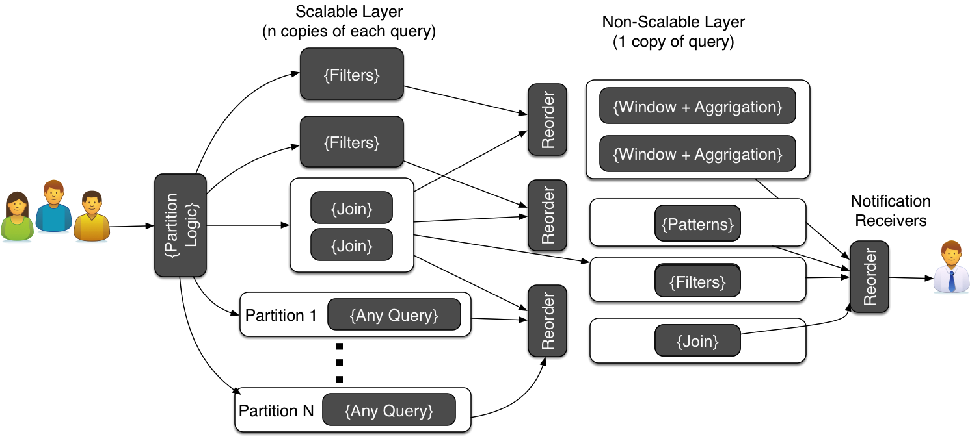
Scaling CEP
Think like MapReduce! ask user to define partitions: parallel and non parallel parts of computations.
Each node as Storm bolt, communication and HA via storm

Slide 28
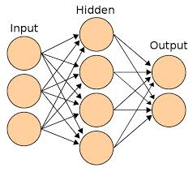
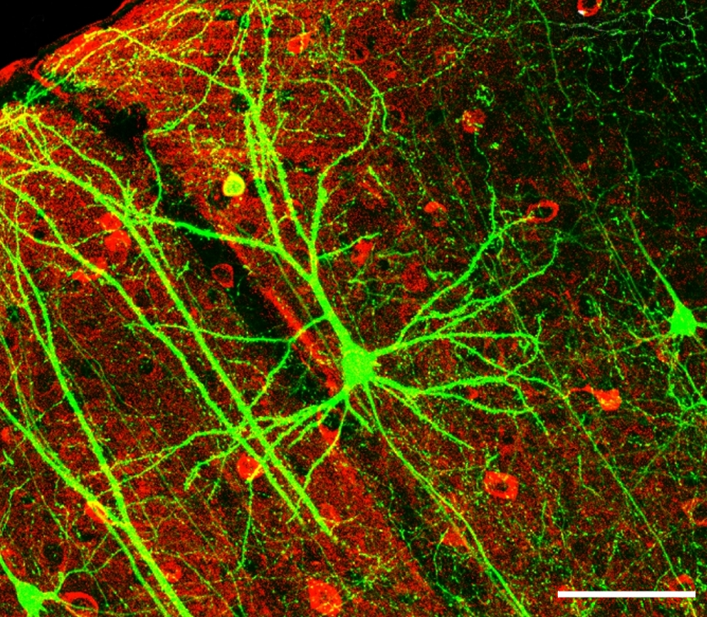
Machine Learning Team
We are building a machine learning team
To give first class support for machine learning within WSO2 platform, specially in Big Data solutions
Idea is to guide you though the process of finding and applying the best model for you dataset and scenario
We will reuse best opensource tools and create what is missing

Slide 29
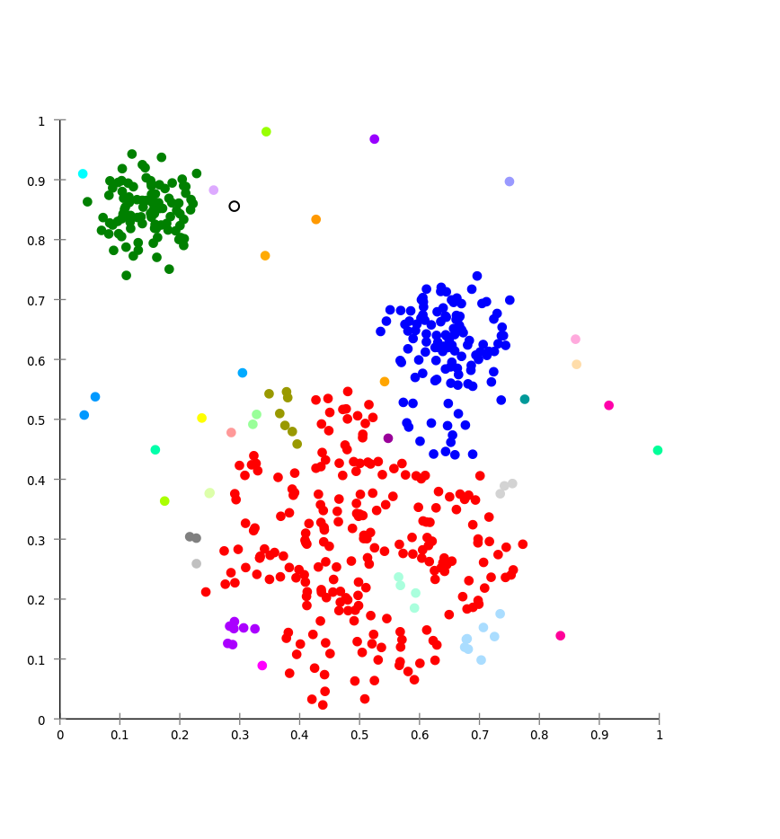
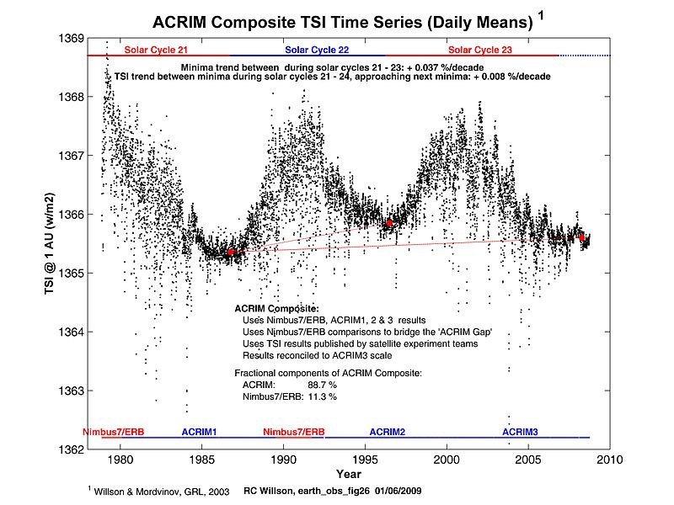
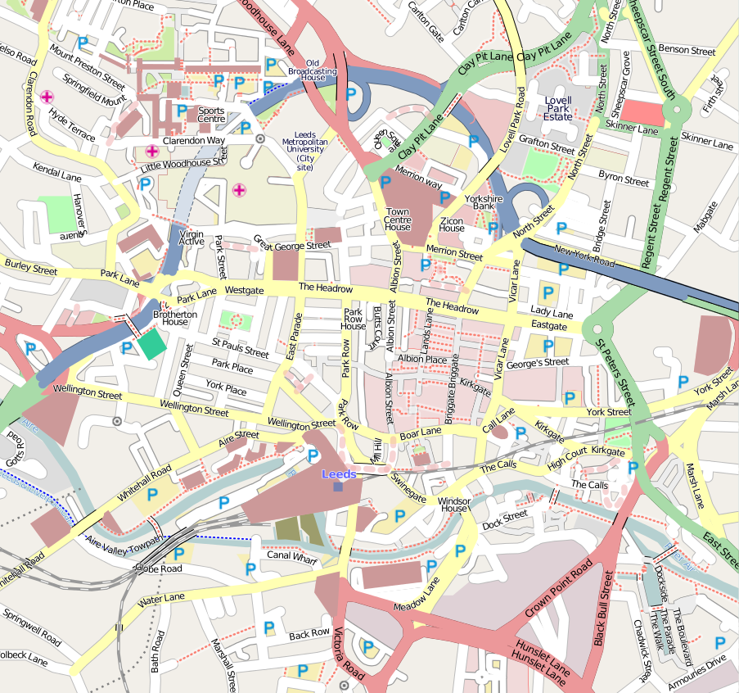
Domain Toolboxes
Time Series Toolbox
Forecasts and outlier detection with cycle support
Fraud Detection
Set of common fraud detection pattern implementations pointing out how you can extend them
GIS support
Operations: within, inside, touches
Geo Fencing
Tracking
Integration with GIS databases

Slide 30
Conclusion
Introduction to Big Data, why and how?
WSO2 Big Data platform
What is new in the platform?
What keeps us busy?
Interested
All the software we discussed are Open source under Apache License. Visit http://wso2.com/.
Like to integrate with us, help, or join? Talk to us at Big Data booth or architecture@wso2.org

Slide 31

Thank You

